Slide 1


EXAMINE THE MICROSTRUCTURE OF PLA5NF FOR 3D PRINTNG FILAMENT
By
AJAY S | - | 211419114017
AKASH M | - | 211419114020
BALA KUMAR J | - | 211419114051
BHUPESH KUMAR K | - | 211419114056
Under the Supervision
of
MR. P. SRIRAM, M.E.,
ASSISTANT PROFESSOR,
DEPARTMENT OF MECHANICAL ENGINEERING,
PANIMALAR ENGINEERING COLLEGE.

Slide 2
ABSTRACT
This study examines the microstructure of PLA5NF, a type of 3D printing filament, using various microscopy techniques. The aim of the study is to gain a better understanding of the material's properties and characteristics at the micro level, which can help improve the quality and performance of 3D printed products. The results show that PLA5NF has a uniform microstructure with a consistent diameter and smooth surface, which is essential for producing high-quality 3D printed objects. The study also reveals the presence of small voids and defects in the material, which could impact its mechanical properties. Overall, the findings of this study provide valuable insights into the microstructure of PLA5NF and its potential for use in 3D printing applications.

Slide 3
Additive Manufacturing:
Additive manufacturing is a process of creating three-dimensional objects by adding material layer by layer, rather than by subtracting material from a larger block, as is done in traditional manufacturing processes.
Additive manufacturing is also known as 3D printing, as it often involves the use of computer-aided design (CAD) software to create digital models of objects, which are then converted into physical objects through the layer-by-layer addition of material.
The materials used in additive manufacturing can vary widely, including plastics, metals, ceramics, and even living cells. This technology has numerous applications, from prototyping and tooling to medical implants and aerospace components.
Additive manufacturing has revolutionized the manufacturing industry by reducing the time and cost associated with producing complex parts, and by allowing for greater design flexibility and customization. Additionally, it has the potential to reduce waste and energy consumption, making it a more sustainable manufacturing process.

Slide 4
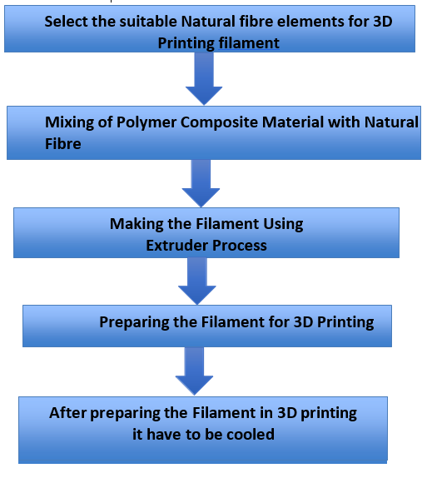
METHODOLOGY:

Slide 5
TYPES OF 3D PRINTERS
Fused Deposition Modeling (FDM)
POLYJET
Stereolithography (SLA)
Digital Light Processing (DLP)
Selective Laser Sintering (SLS)
ELECTRON BEAM (EBM)
MULTI JET FUSION (MJF) ETC.

Slide 6
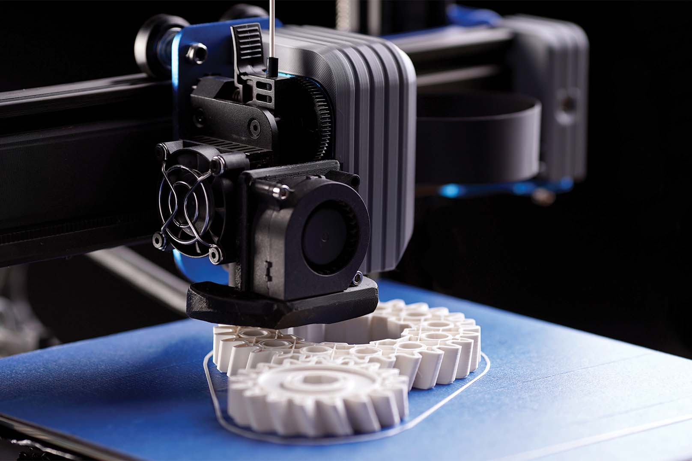
FUSED DEPOSITION MODELING (FDM):
Fused Deposition Modeling (FDM) is a type of additive manufacturing technology that uses a thermoplastic filament as the material. The filament is heated and extruded through a nozzle, which moves in a specific pattern to create the object layer by layer. FDM is widely used in 3D printing for prototyping and small-scale production.
ADVANTAGES OF FDM:
Versatility
Cost-effective
Low waste
Fast turnaround

Slide 7
TYPES OF FILAMENT
PLA FILAMENT
PVA FILAMENT
ABS FILAMENT
FLEX FILAMENT
CONDUCTIVE FILAMENT
NYLON FILAMENT
WOOD FILAMENT ETC.

Slide 8
FIBRE
Fibre refers to a flexible, thin, and thread-like material that is used to create textiles, fabrics, and other materials. Fibers can be made from a variety of materials, including natural sources such as cotton, wool, and silk, as well as synthetic materials such as polyester and nylon. They can be spun into yarn or thread, which can then be woven or knitted into fabrics. Fibers can also be used to create composite materials, such as carbon fiber, which have high strength and durability.
Fibers play an important role in many industries, including textiles, fashion, construction, and automotive. The properties of the fiber, such as its strength, flexibility, and thermal properties, can be modified through various treatments and coatings, allowing it to be used in a wide range of applications.

Slide 9
TYPES OF NATURAL FIBRE
FLAX
COIR
COTTON
KENAF
JUTE
HEMP
LINEN ETC.

Slide 10
MATERIALS USED:
Polylactic Acid
Flax Fiber
Polylactic Acid:
Polylactic Acid (PLA) is a biodegradable and compostable thermoplastic that is commonly used as a filament material in Fused Deposition Modeling (FDM) 3D printing. PLA is made from renewable resources such as corn starch and sugarcane, making it a popular eco-friendly option for 3D printing. It has good mechanical properties and is easy to print with, making it a suitable choice for a wide range of applications.
Flax Fiber:
Flax fiber is a natural plant-based material that is commonly used as a reinforcement in composites, including in the manufacturing of car parts and construction materials. It is lightweight, strong, and has good mechanical properties, making it a suitable alternative to traditional materials such as fiberglass. Flax fiber is also eco-friendly and sustainable, as it is made from a renewable resource and is biodegradable.

Slide 11
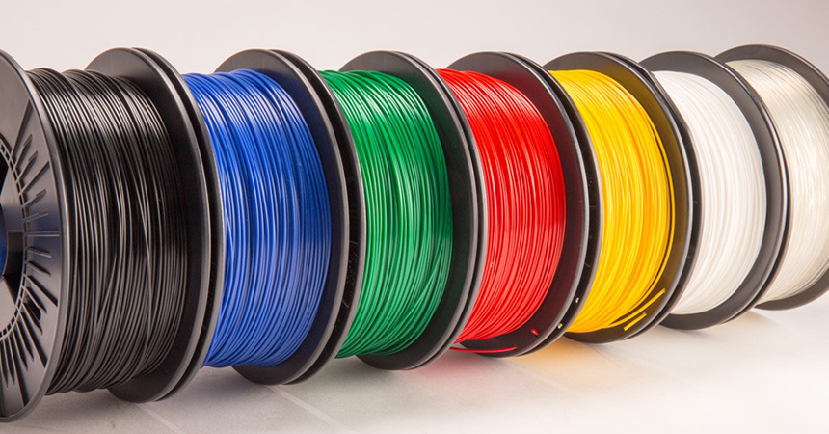
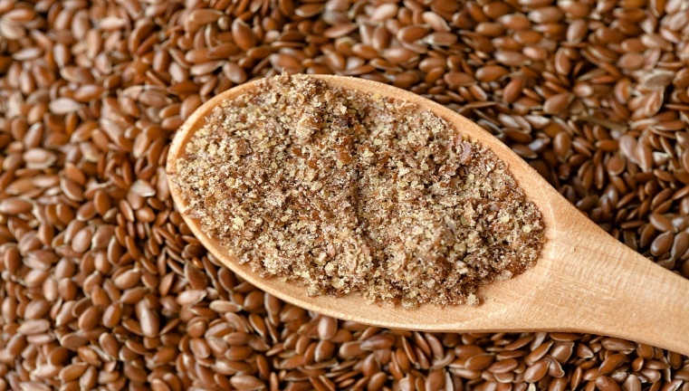
Materials Used to Make Filament
PLA
FLAX POWDER

Slide 12
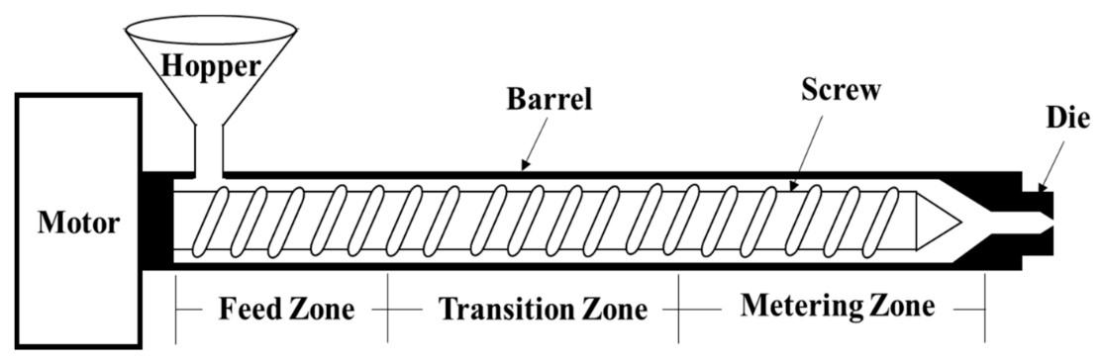
PREPARATION OF FILAMENT:
A filament making machine is a device used to produce 3D printer filament. It is typically used by manufacturers or hobbyists who want to create their own custom filament blends or colors. The filament making process involves melting plastic pellets and extruding the molten plastic through a small nozzle to create a thin, continuous filament. The filament is then wound onto a spool for use in a 3D printer.
Nozzle Diameter = 2 mm to 1.75 mm
Temperature in Barrel is 160℃, 180℃, 200℃.

Slide 13
PROCESS:
The process of filament extrusion involves the use of a filament extrusion device, which is typically made up of several components. Here is an overview of the process:
Material preparation: The first step in filament extrusion is to prepare the raw material. This is typically done by loading plastic pellets or other raw materials into the hopper of the filament extrusion device.
Material feeding: The raw material is then fed into the extruder barrel through the hopper. The extruder barrel is heated to melt the plastic material, which is then forced through a small opening in the nozzle.
Filament formation: As the melted plastic material is extruded through the nozzle, it is shaped into a filament of a specific diameter and consistency. The filament is then pulled through a cooling system to solidify it and ensure that it retains its shape.
Filament winding: Once the filament has been cooled and hardened, it is wound onto a spool using a motorized spooling system. The spool is rotated automatically to ensure that the filament is wound evenly and with the correct tension.

Slide 14
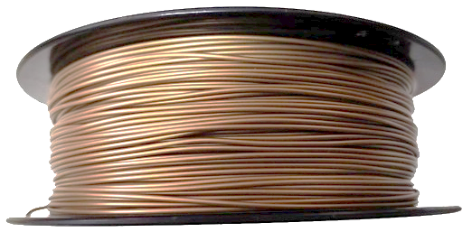
Quality control: Throughout the extrusion process, the diameter of the filament is carefully monitored to ensure that it remains consistent. Any variations or defects are detected and corrected using feedback mechanisms built into the filament extrusion device.
Filament cutting: Once the filament has been wound onto the spool, it may be cut to the desired length using a cutting system attached to the filament extrusion device. Overall, the process of filament extrusion is a precise and carefully controlled process that requires careful attention to temperature, pressure, and speed to ensure that the resulting filament is of high quality and meets the desired specifications.

Slide 15
SCANNING ELECTRON MICROSOPY (SEM)
SEM stands for Scanning Electron Microscope, which is an advanced type of microscope that uses a beam of electrons to produce high-resolution images of surfaces and materials at the micro and nano scale. Unlike optical microscopes, which use visible light to produce images, SEMs use a beam of electrons that is focused on the sample being examined. As the electrons interact with the sample, they produce signals that are detected and used to create an image of the sample's surface.
SEM technology offers several advantages over traditional optical microscopes, including much higher magnification and resolution, and the ability to study samples in greater detail. SEMs are widely used in many fields, including materials science, engineering, biology, and geology, for a variety of applications such as examining the surface morphology of materials, analyzing the elemental composition of samples, and studying the structure of biological specimens. SEM technology has become an essential tool in scientific research and is continuing to be developed and refined for even greater precision and imaging capabilities.

Slide 16
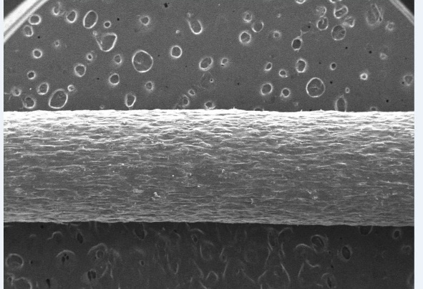
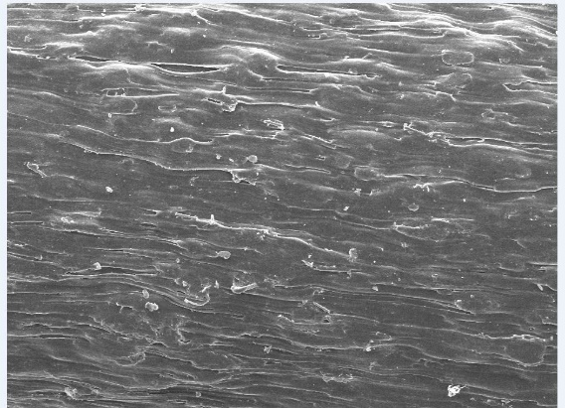
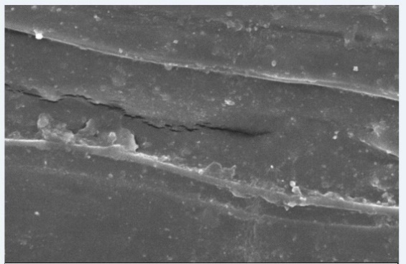
SEM RESULTS

Slide 17
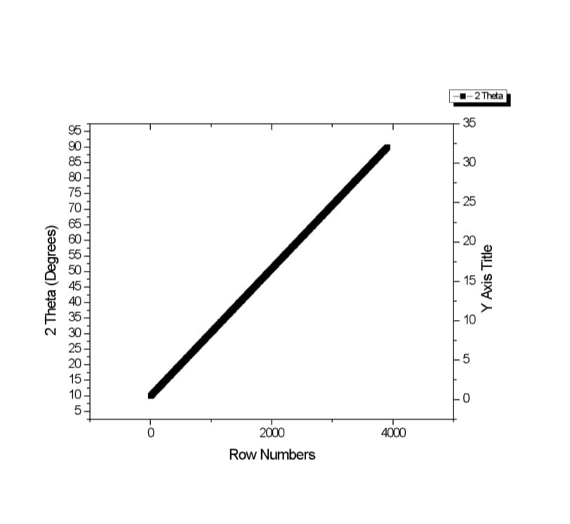
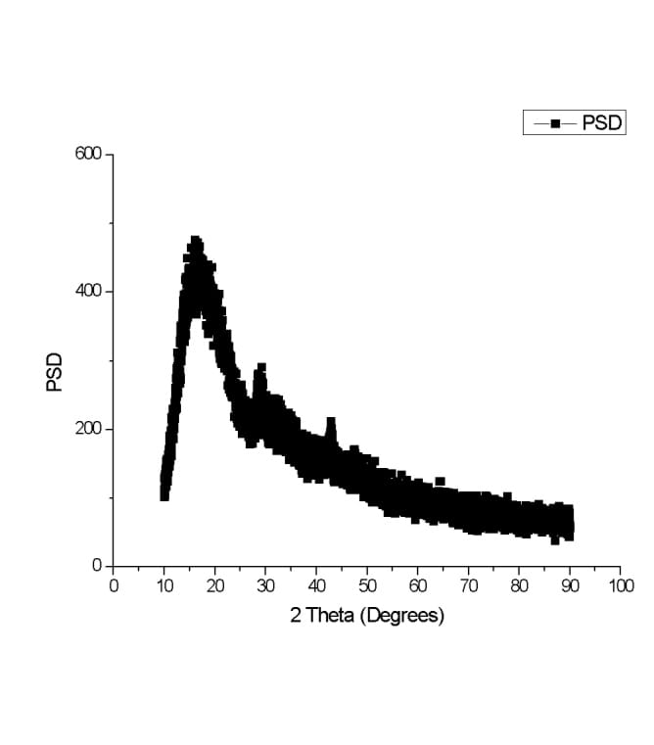
X-RAY DIFFRACTION
This test method is performed by directing an x-ray beam at a sample and measuring the scattered intensity as a function of the outgoing direction. Once the beam is separated, the scatter, also called a diffraction pattern, indicates the sample’s crystalline structure. The Rietveld refinement technique is then used to characterize the crystal structure which most likely provided the observed pattern.

Slide 18
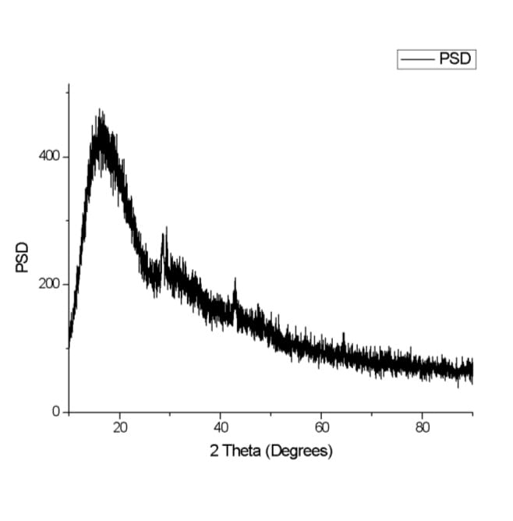
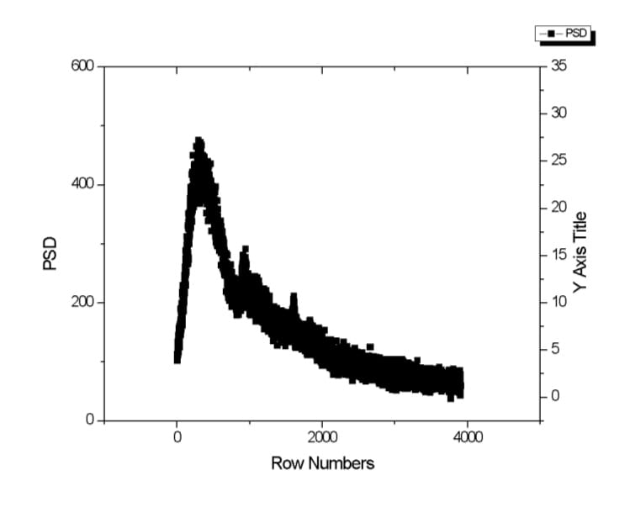
GRAPH

Slide 19
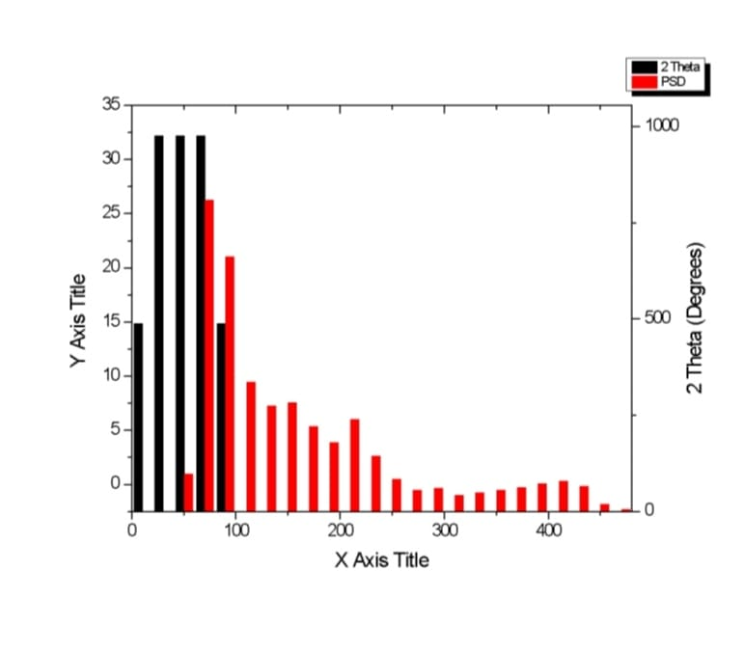
GRAPH

Slide 20
CONCLUSION
In conclusion, the examination of the microstructure of PLA5NF for 3D printing filament has revealed several important insights into the behavior and properties of this material. The microstructural analysis showed that the addition of 5% Natural fibers to the PLA filament led to improvements in the thermal and mechanical properties of the resulting 3D printed parts, such as increased stiffness and tensile strength.
The examination also revealed that the Natural fibers were well dispersed within the PLA matrix, indicating good compatibility between the two materials. Furthermore, the study found that the addition of the Natural fibers did not significantly affect the crystallinity or melting behavior of the PLA.
These findings suggest that PLA5NF has great potential as a high-performance and sustainable material for 3D printing applications. By understanding the microstructure of this material, researchers and manufacturers can optimize the processing and properties of PLA5NF-based filaments and 3D printed parts. This could lead to the development of new and innovative products that are both functional and environmentally friendly.

